Slide 1
More than words
WebExpo
Léonie Watson

Slide 2
Hello!

Slide 3

Recognition

Slide 4

MGM

Slide 5

Intel

Slide 6

McDonald’s

Slide 7

Marks and Spencer

Slide 8
Architecture

Slide 9


In the cloud
Home assistants
Cloud-based applications

Slide 10

On device
Web readers
Screen readers

Slide 11
Synthetic speech

Slide 12
Formant TTS
Formant synthesis is rule based. The acoustic characters of speech are extracted from a voice recording, then programmed as rules for recreating the voice as digital audio.

Slide 13
Concatenative TTS
Concatenative synthesis uses a voice recording that's broken down into tiny chunks. The chunks are then reconstructed from a database to form the synthesized speech.

Slide 14
Parametric TTS
Parametric synthesis uses a statistical model. The parameters of speech are extracted from a voice recording, then Hidden Markov Models (HMM) modify the parameters based on the text to be spoken.
Notes:
Traditional TTS uses rule-based or statistical techniques, dependent on pre-defined linguistic and acoustic models, with a two step process:
1. Linguistic analysis
2. Acoustic production

Slide 15
Neural TTS
Neural TTS uses artificial neural networks trained on huge amounts of voice data. The neural networks learn the relationships between text and speech, and the result is voices that sound very close to human speech.
Notes:
Neural (NTTS) uses a single end-to-end process that's trained on vast amounts of speech data.

Slide 16
Prosody
She said she did not hide his socks.
Notes:
Prosody is the term for the variables that make someone's speech distinctive: speed, pitch, rhythm, and relative emphasis.
Traditional TTS do not handle prosody well. That's why they usually sound artificial.

Slide 17
Emotion
Hello, my name is Peter. When the news is so depressing I feel like I'm going to cry [CRYING].
But I can also be the life of the party when things turn out to be funny [LAUGHING].

Slide 18
Clones
Neural TTS can transfer the prosodic characteristics of one voice to another, making it possible to synthesize speech in the voice of a particular speaker (with comparatively little individual training data).

Slide 19
Find your voice

Slide 20
Characteristics
Gender
Accent
Prosody

Slide 21
Gender
Notes:
The reason that digital assistants like Alexa were given a female voice is because it supposedly embodies our idea of a capable, competent, efficient, and trustworthy person.
In 2019, a UNESCO report found that assigning female voices to digital assistants was helping to entrench harmful gender biases in society.
If you're rolling your eyes at that, consider the fact that Watson, IBM's AI for business, was assigned a male voice for it's work with physicians on treatments for cancer.
Apple dropped a default voice assignment for Siri in iOS14., letting people choose their preferred voice during setup instead. You can change the voice for Alexa and Google Assistant, but female voices remain the default.
This is all very well, but there are few choices for non-binary or genderless voices available on any platform.
Apple introduced Quin in iOS15.4 (voice number 5 if you choose North American as your language), but that's about it. Which is why I'd like to introduce you to Q.

Slide 22
Meet Q
Hi, I'm Q. The world's first genderless voice assistant. Think of me like Siri or Alexa, but neither male nor female.
I'm created for a future where we are no longer defined by gender, but rather, how we define ourselves.

Slide 23

Speech Synthesis Markup Language (SSML)
https://w3.org/TR/speech-synthesis/

Slide 24
The <voice> element
let responsePrompt = `<voice name='Brian'>
<s>Piglet sidled up to Pooh from behind.</s>
</voice>`;

Slide 25
Prosody

Slide 26
The <prosody> element
let responsePrompt =
`<voice name=‘Brian’>
<s><prosody pitch='x-high' rate=‘medium’ volume='soft'>'Pooh'</prosody> he whispered.</s>
</voice>`;

Slide 27
The <break> element
let responsePrompt =
`<voice name='Brian’>
<s><prosody pitch='x-high’ rate=‘x-fast’>
Nothing</prosody>
said Piglet, taking Pooh's paw.
<break time='500ms'/></s>
</voice>`;

Slide 28
The <emphasis> element
let responsePrompt =
`<voice name='Brian'>
<s><prosody pitch='x-high' rate='x-fast'>
'I just wanted to be <emphasis level='strong'>sure</emphasis> of you'.</prosody></s>
</voice>`;

Slide 29
The whole story
Piglet sidled up to Pooh from behind.
Pooh! he whispered.
Yes Piglet?
Nothing, said Piglet, taking Pooh's paw.
I just wanted to be sure of you.

Slide 30
Emotion

Slide 31
The <amazon:emotion> element
let responsePrompt =
`<amazon:emotion>
<p>I'm so excited (and I just can't hide it)!</p>
</amazon:emotion>`;

Slide 32
With name=excited”
let responsePrompt =
`<amazon:emotion name='excited' intensity='high’>
<p>I'm so excited (and I just can't hide it)!</p>
</amazon:emotion>`;

Slide 33
With name=“disappointed”
let responsePrompt =
`<amazon:emotion name=‘disappointed' intensity='high’>
<p>I'm so excited (and I just can't hide it)!</p>
</amazon:emotion>`;

Slide 34
The <say-as> element
let responsePrompt =
`<voice name='Joey’>
<lang xml:lang='en-US’>
<s><say-as>...</say-as></s>
</lang>
</voice>`;

Slide 35
The <say-as interpret-as="expletive”> element
let responsePrompt =
`<voice name='Joey’>
<lang xml:lang='en-US’>
<s>Frankly my dear, I don't give-a
<say-as interpret-as='expletive'>damn!</say-as></s>
</lang>
</voice>`;

Slide 36
The <say-as interpret-as=“interjection“> element
let responsePrompt =
`<say-as interpret-as='interjection’>
<s>Ace. As if. Bah humbug. Blimey. Cha ching. Crikey.
Eek. Good Grief. Hiss. Moo. Nom nom. Oof. Oy. Simples.
Tick tick tick. Uh huh. Whee.
</s>
</say-as>`;

Slide 37
With no emotion
I’m sorry Dave, I’m afraid I can’t do that
.

Slide 38
Closing the gap

Slide 39
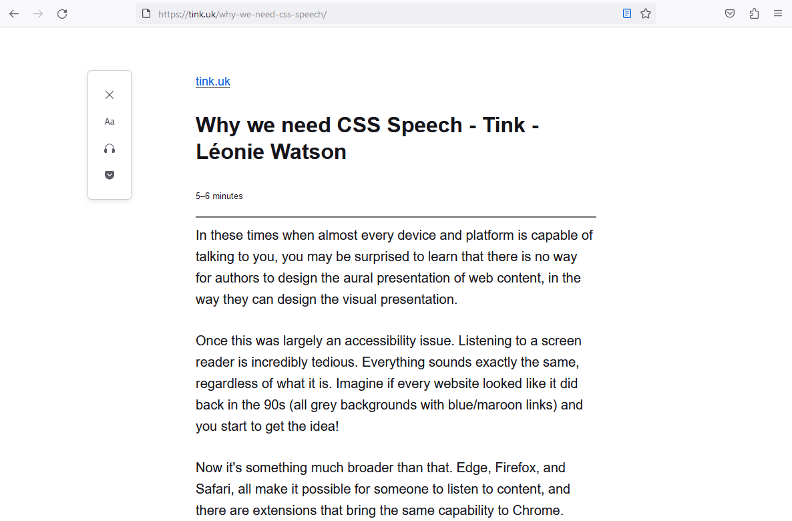
Web readers

Slide 40
The CSS Speech module
https://w3.org/TR/css-speech-1/

Slide 41

Browser implementations

Slide 42
The voice-family property
voice-family: “Voice Name 1”, “Voice Name 2”;
https://speech-api-voices-gatherer.glitch.me/
Notes:
Takes the names of available voices in preference order.

Slide 43
The speak property
{speak: auto;}
Notes:
Other values are never and always.

Slide 44
The prosody properties
{
voice-volume: normal;
voice-pitch: normal;
voice-rate: normal;
}
Notes:
Other voice-volume values are x-soft, soft, medium, loud, x-loud.
Other voice-pitch properties are x-low, low, medium, high, x-high.
Other voice-rate values are: x-slow, slow, medium, fast, x-fast.

Slide 45
The emphasis properties
{
voice-stress: normal;
voice-range: medium;
}
Notes:
The other voice-stress values are strong, moderate, none, reduced.
The other voice-range values are x-low, low, high, x-high.

Slide 46
The pause properties
{
pause-before: medium;
pause-after: medium;
}
Notes:
Other pause-before and pause-after properties are none, x-weak, weak, strong, x-strong.

Slide 47
The speak-as property
{
speak-as: spell-out;
}
{
say-as: digits;
}
Notes:
Other say-as values are literal-punctuation, no-punctuation.

Slide 48
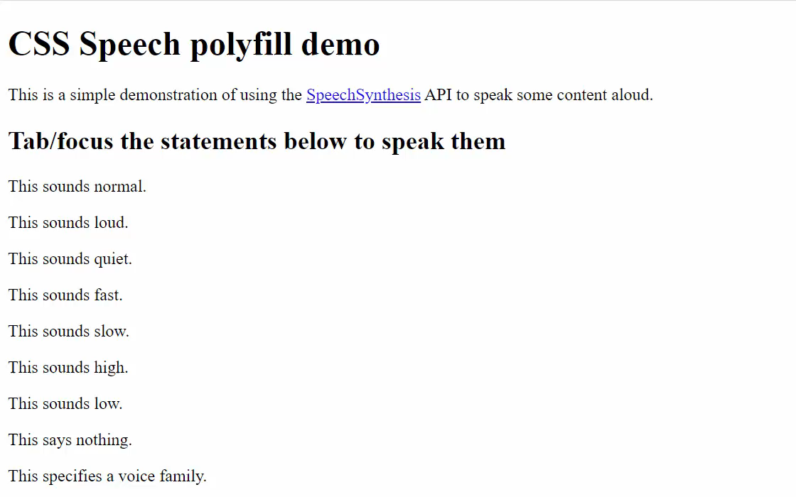
CSS Speech polyfill
https://www.kryogenix.org/code/browser/css-speech-polyfill/css-speech.html
Notes:
Created in collaboration with Stuart Langridge @sil@mastodon.social.

Slide 49





A new setting?

Slide 50
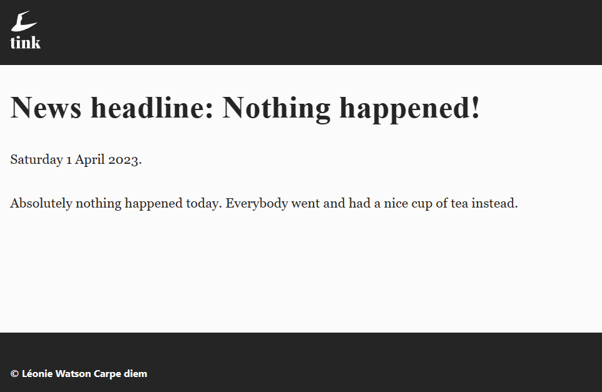
A better UX

Slide 51
A call to action
Show your support for CSS Speech:
https://tink.uk/why-we-need-css-speech/

Slide 52
Thank you!
WebExpo

